Slide 1
Feb 2022 PM2.5 presentation to Hamtramck Coalition
Denise Trabbic-Pointer, MS, CHMM Emeritus
Sierra Club - Michigan Chapter
Volunteer: Toxics and Remediation Specialist

Slide 2
PM2.5 Prevalence in Zip Codes 48211, 48212, and 48213
There are three (3) key air quality monitoring stations (AQS) used to assess ambient contaminants, including PM2.5 in these zip codes.
Allen Park and Port Huron AQS are used to assess differences in data for the E 7 Mile Rd AQS
Nearest Air quality monitoring station | E 7 Mile (261630019) station. Downwind.
Allen Park air quality monitoring station | 26-163-0001 AQS ID. Upwind
Port Huron air quality monitoring station | 261470005 AQS ID. Downwind

Slide 3
Proximity of Hamtramck to Up and Downwind AQS
The red icon indicates the location of the US Ecology – Detroit South facility
The Green is just indicating Hamtramck
The blue are the 3 AQS: Allen Park, E 7 Mile and Port Huron

Slide 4
Acceptable Limits and Health Impacts from PM2.5 Exposure
Breathing in particle pollution can be harmful to your health. Coarse (bigger) particles, called PM10, can irritate your eyes, nose, and throat. Dust from roads, farms, dry riverbeds, construction sites, and mines are types of PM10.
Fine (smaller) particles, called PM2.5, are more dangerous because they can get into the deep parts of your lungs — or even into your blood.
Particle pollution can affect anyone, but it bothers some people more than others. People most likely to experience health effects caused by particle pollution include:
People with heart or lung diseases (for example, asthma)
Older adults
Babies and children
Fine particulate matter is classified as a criteria pollutant and has a NAAQS based on both a December 2012, 24-hour value of 35 ug/m3 and an annual 3-year average of 12 ug/m3. PM2.5 NAAQS are under review to reduce.

Slide 5
PM2.5 Emissions from Nearest AQS
The OSHA PEL for respirable dust in the workplace is 5 mg/m3 (5,000 ug/m3)
The ACGIH TLV for respirable dust is 3 mg/m3 (3,000 ug/m3)
One ug/m3 in ambient air = one ppb = 0.001 ppm

Slide 6
PM2.5 Emissions from Nearest AQS
The OSHA PEL for respirable dust in the workplace is 5 mg/m3 (5,000 ug/m3)
The ACGIH TLV for respirable dust is 3 mg/m3 (3,000 ug/m3)
One ug/m3 in ambient air = one ppb = 0.001 ppm

Slide 7
US Ecology – Detroit South Air Permit
The US Ecology – Detroit South Facility air permit does not include a requirement specific to PM2.5.
The most frequent odor complaints are related to the emissions unit EUTREATMENT.
They stabilize wastes in this EU and Reagents include: lime, cement kiln dust, ferrous sulfate, sand, and fly ash.
Most odor complaints are described as “Lime dust and Chemical-Type”. SDS describe as “Slight Sulfur odor”
Lime dust typically contains crystalline silica quartz at > 1 to 2 %
POLLUTION CONTROL EQUIPMENT: All emissions from the stabilization building are controlled by a baghouse and vented to the atmosphere through two stacks.
We don’t know whether odor complaints equate to actual PM2.5 or lime dust emissions to ambient air. Observed airborne particulate should also be reported. I would expect there would be a visible cloud if emissions are above permit limits.

Slide 8
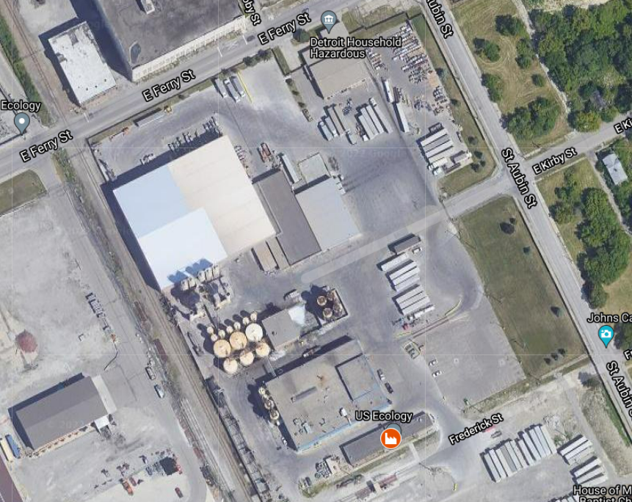
Chemical Fixation Building

Slide 9
What is Crystalline Silica Quartz?
Silica, or silicon dioxide (SiO2), is a group IV metal oxide, which naturally occurs in both crystalline and amorphous forms (i.e. polymorphic; NTP, 2005).
The various forms of crystalline silica are: α-quartz, β-quartz, α-tridymite, β-tridymite, α-cristobalite, β-cristobalite, keatite, coesite, stishovite, and moganite (NIOSH, 2002).
The most abundant form of silica is α-quartz, and the term quartz is often used in place of the general term crystalline silica (NIOSH, 2002).
One consideration with any chronic health hazard risk is cumulative effects. Most times there isn’t just one contaminant in environmental media and especially ambient air. If a thorough assessment and speciation of contaminants is done, the assessment of a health hazard index and risk to human health is most accurate. Such a study was done in zip code 48217.

Slide 10
US Ecology – Detroit South and Crystalline Silica Quartz
There is no way to know if EUTREATMENT is emitting Silica or PM2.5 without testing for it at the stack or fenceline and doing so is not required by permit or other regulation.
Whether from US Ecology or other industry, there are slightly higher levels of PM2.5 indicated in the areas between Allen Park and E 7 Mile. The Gordie Howe International Bridge project is one other possible source as mentioned in the report.
People in the community should understand the possible health impacts from PM2.5 and Crystalline Silica Quartz. Symptoms of chronic exposure Silica include
The predominant effect of overexposure to airborne quartz in humans is silicosis. Silicosis is a chronic disease characterized by the formation of silica-containing nodules of scar tissue in the lungs. Silicosis in which the nodules are less than 1 cm in diameter is generally asymptomatic. With continued exposure, and in some cases even in the absence of continued exposure, the development of silicosis can become more complicated with symptoms of coughing, dyspnea, wheezing, and nonspecific respiratory ailments (ACGIH 2006; Patty 1981).

Slide 11
US Ecology – Detroit South Air Permit and Crystalline Silica Quartz
NAAQS = 24-hour value of 35 ug/m3 and an annual 3-year average of 12 ug/m3
It is important to note that exposure to Silica is most likely and best researched in the workplace. The OSHA PEL for silica = 50 ug/m3 (TWA) with an action level of 25 ug/m3. The ACGIH TLV = 100 ug/m3 (TWA)
This form of dust is so small that it can stay in the air for up to 12 days. Sometimes when we don’t see dust, there are still particles circulating about!
The only way to know if an individual has been impacted by Silica exposure is through a physical exam.
The Silica Physical Exam generally consists of:
Medical and Occupational History Review.
Physical Examination - A physical examination focusing on the respiratory system.
Chest X-Ray with B Reader - A chest X-ray with interpretation by a certified B-reader.
Pulmonary Function & Spirometry Test.
The described chest X-Ray is key to a positive ID of Silicosis.

Slide 12
References and Questions
Questions?
References
CDC Particulate Pollution
July 2021 Annual Ambient Air Monitoring Network Review
OSHA Workplace exposure to Silica
NIOSH (2002). NIOSH Hazard Review: Health Effects of Occupational Exposure to Respirable Crystalline Silica
Non-occupational exposure to silica dust
48217 Community Air Monitoring Project
US Ecology Detroit South, also known as EQ Detroit FAQ

